Slide 1
Variables and Operators in Python
2021/10/12
Hongfei Yan

Slide 2
Prerequisites
Turning Machine
ASCII (American Standard Code for Information Interchange)

Slide 3
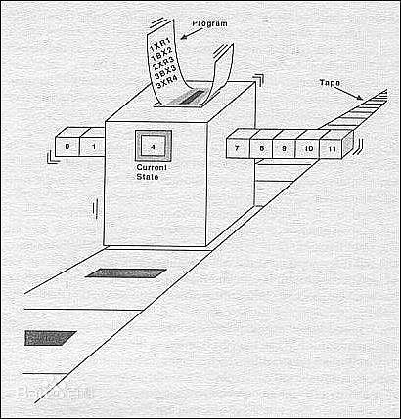
图灵机的构成
一条存储带
双向无限延长
上有一个个小方格
每个小方格可以存储一个数字
一个控制器
包含一个读写头，可以读、写、更改存储带上每一格的数字
可以接受设定好的程序语句
可以存储当前自身的状态
可以变换自身的状态
可以沿着存储带一格一格地左移/右移

Slide 4
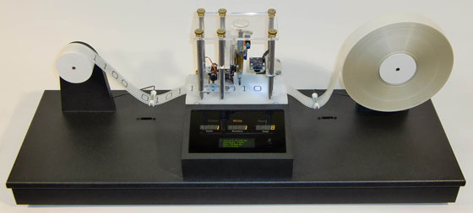
A Turing Machine http://www.aturingmachine.com/index.php

Slide 5
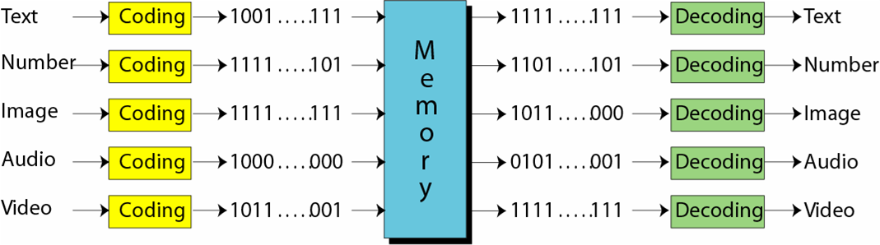
Bit, bit pattern, byte
计算机内的数据采用统一的数据表示
位: 存储在计算机中的最小数据单位，0或1
位模式: 表示数据的位序列，或位流
字节: 长度为8的位模式称为字节

Slide 6
文本的表示
在任何语言中, 文本都是由一些符号组成
位模式可以表示任何一个符号
需要多少位(bit)来表示一个符号取决于该语言使用的符号的数量

Slide 7
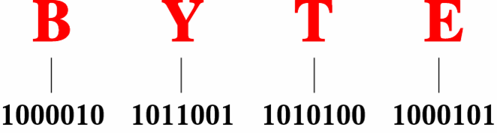
字符代码-ASCII
存在不同的表示文本符号的位模式集合
每个集合被称为代码,
表示符号的过程称为编码.
ASCII
(computer science) a code for information exchange between computers made by different companies;
a string of 7 binary digits represents each character; used in most microcomputers
Notes:
基于英文,使用7位表示每个符号,范围从0000000-1111111
只适合表达英语, 不支持其它语种

Slide 8
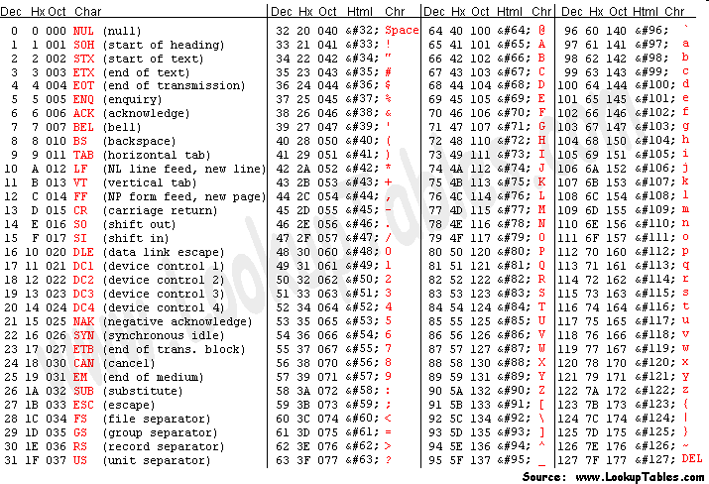
Notes:
ASCII reserves the first 32 codes (numbers 0–31 decimal) for control characters: codes originally intended not to carry printable information, but rather to control devices (such as printers) that make use of ASCII. For example, character 10 represents the "line feed" function (which causes a printer to advance its paper), and character 27 represents the "escape" key often found in the top left corner of common keyboards. Code 127 (all seven bits on), another special character, equates to "delete" or "rubout". Though its function re ...

Slide 9

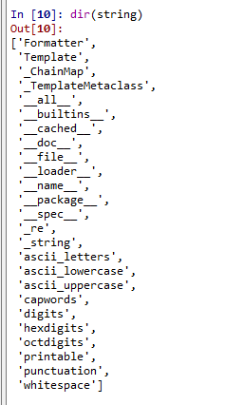

Slide 10
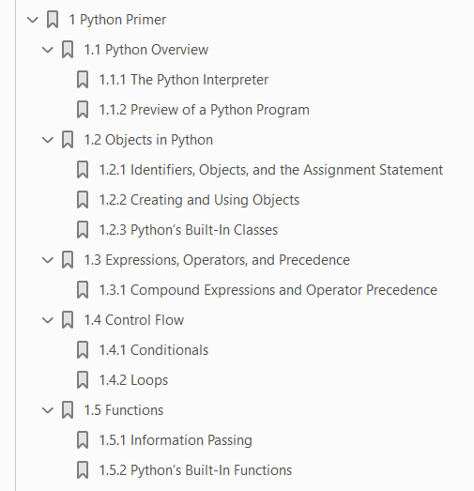
Contents
1 Python Primer 1
1.1 Python Overview 2
1.2 Objects in Python 4
1.3 Expressions, Operators, and Precedence 12
1.4 Control Flow 18
1.5 Functions 23
1.6 Simple Input and Output 30
1.7 Exception Handling 33
1.8 Iterators and Generators 39
1.9 Additional Python Conveniences 42
1.10 Scopes and Namespaces 46
1.11 Modules and the Import Statement 48
Data Structures and Algorithms in Python by Michael T. Goodrich and Roberto Tamassia, Mar 18, 2013

Slide 11
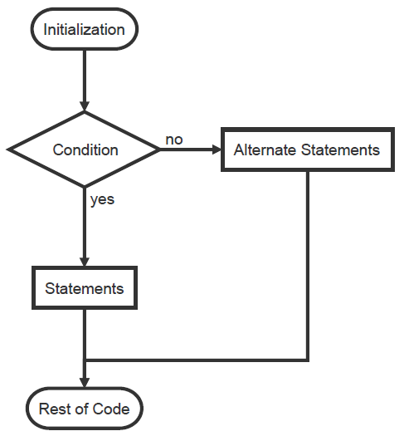
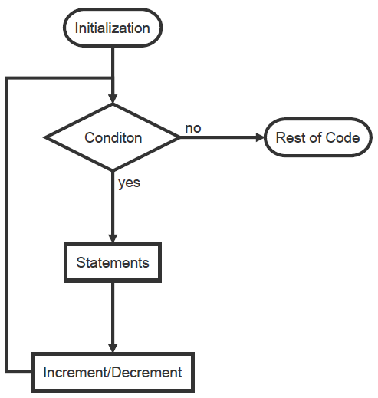
Control Flow/Structure: Conditionals & Loops

Slide 13
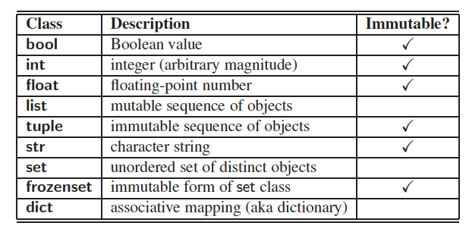
https://www.ics.uci.edu/~pattis/ICS-33/lectures/complexitypython.txt

Slide 14
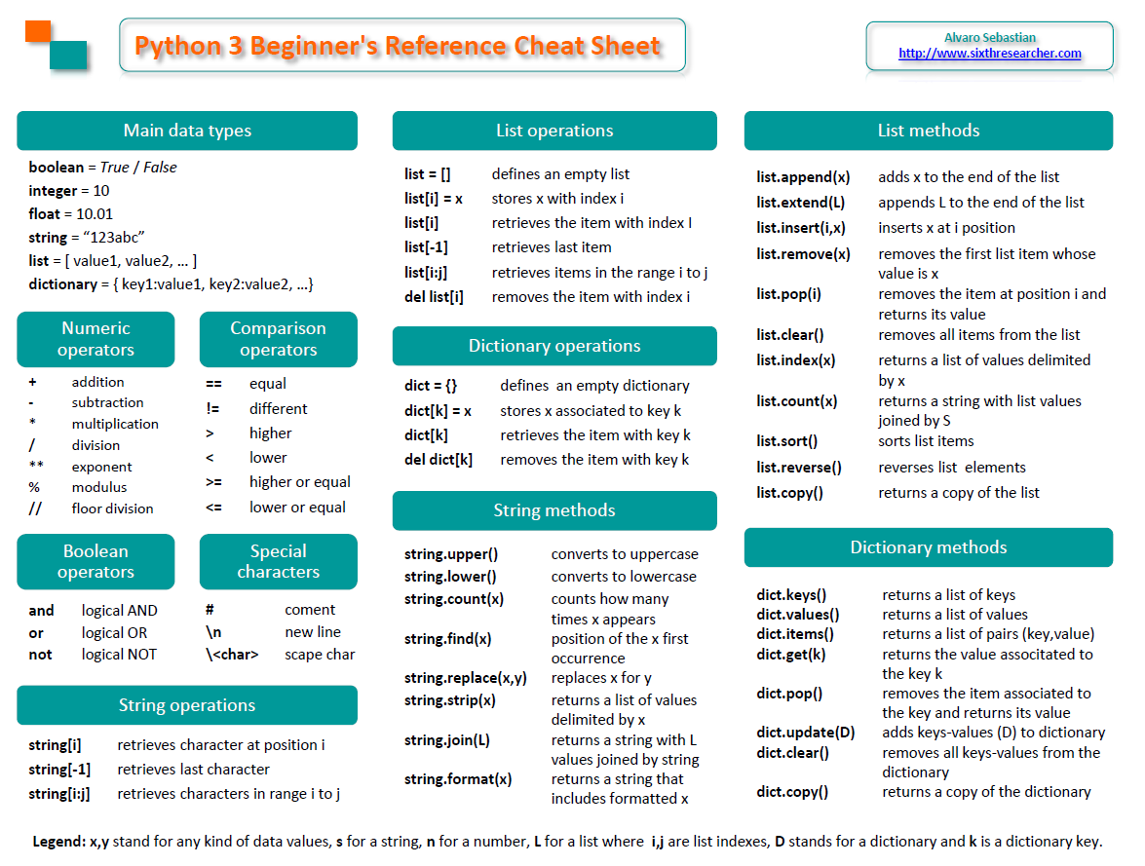

Slide 15
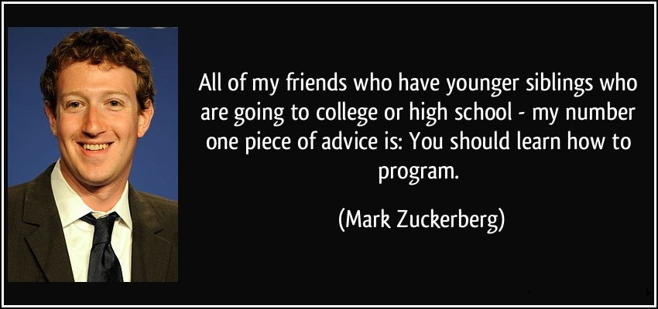
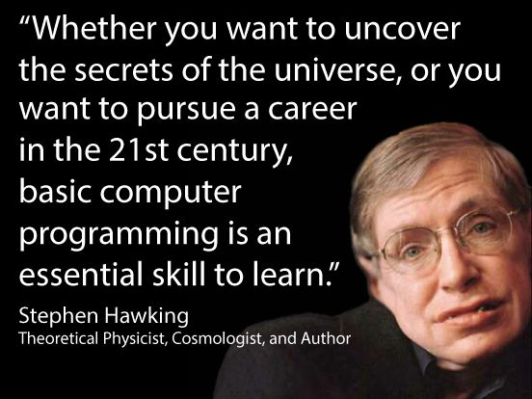
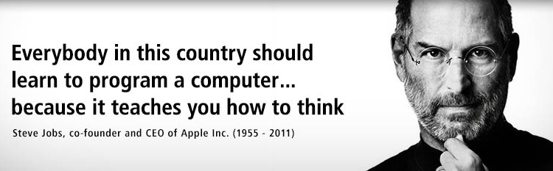

Slide 16

Warm up glossary@The Python Tutorial
argument
class
dictionary
duck-typing
expression
function
generator
iterable
lambda
list comprehension
method
mutable
object
parameter
Pythonic
Sequences
……
Notes:
https://docs.python.org/3/tutorial/index.html
The Glossary is also worth going through.
https://docs.python.org/3/glossary.html#glossary

Slide 17
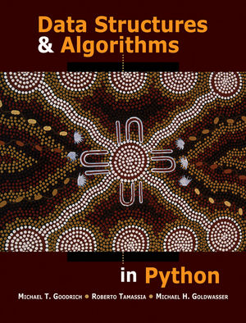
Data Structures & Algorithms in Python http://www.wiley.com/WileyCDA/WileyTitle/productCd-EHEP002510.html
by Michael T. Goodrich and Roberto Tamassia, Mar 18, 2013
2019年诺贝尔化学奖，三位得主分别是John B. Goodenough、M. Stanley Whittingham、吉野彰，以表彰他们对锂离子电池的发展做出的贡献。
Notes:
https://doc.lagout.org/programmation/python/Data%20Structures%20and%20Algorithms%20in%20Python%20[Goodrich,%20Tamassia%20&%20Goldwasser%202013-03-18].pdf

Slide 18
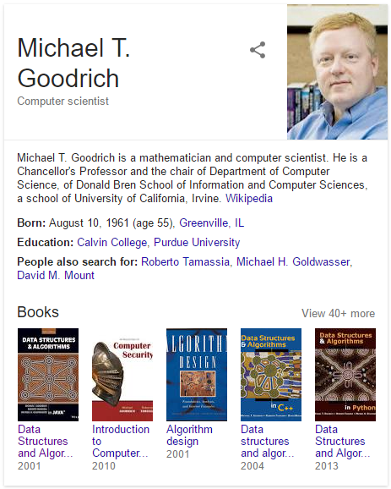
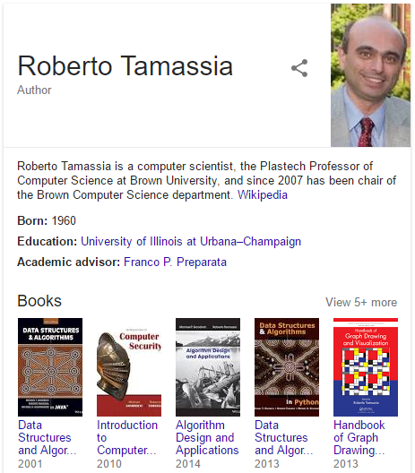

Slide 19
1.1 Python Overview
1.1.1 The Python Interpreter
1.1.2 Preview of a Python Program

Slide 20
1.1.1 The Python Interpreter
Python is an interpreted language.
Commands are executed through the Python interpreter.
The interpreter receives a command, evaluates that command, and reports the result of the command.
A programmer defines a series of commands in advance and saves those commands in a text file known as source code or a script.
For Python, source code is conventionally stored in a file named with the .py suffix (e.g., demo.py).

Slide 21
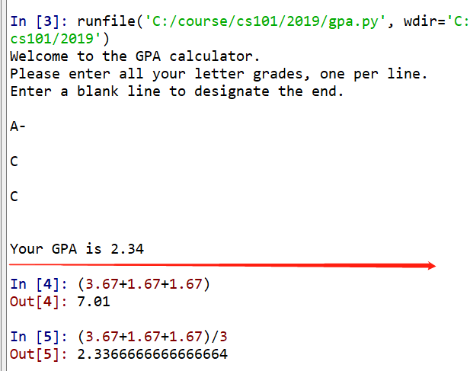
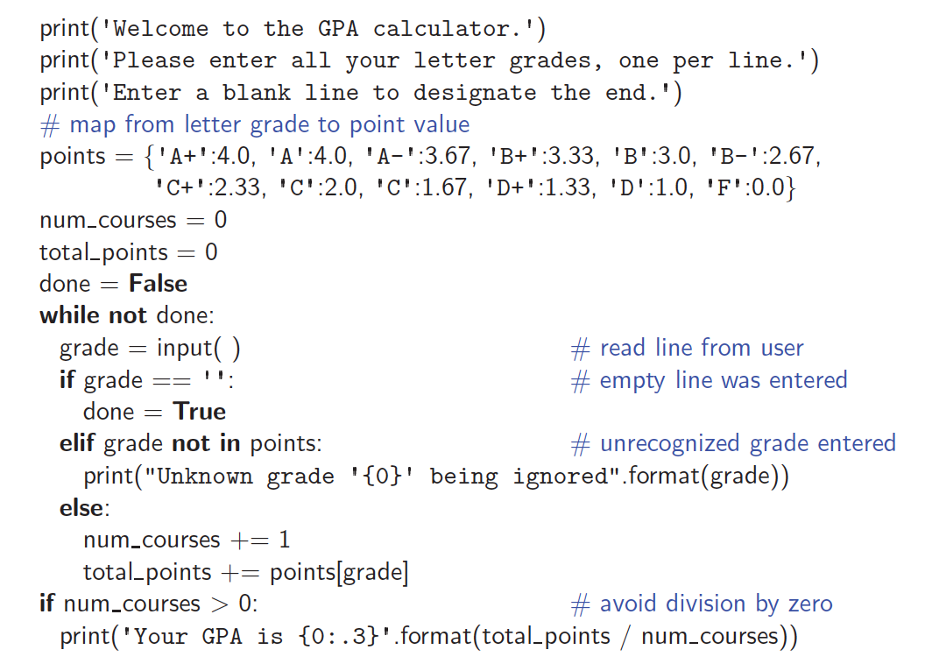
Notes:
print('Welcome to the GPA calculator.')
print('Please enter all your letter grades, one per line.')
print('Enter a blank line to designate the end.')
# map from letter grade to point value
points = {'A+':4.0, 'A':4.0, 'A-':3.67, 'B+':3.33, 'B':3.0, 'B-':2.67,
'C+':2.33, 'C':2.0, 'C':1.67, 'D+':1.33, 'D':1.0, 'F':0.0}
num_courses = 0
total_points = 0
done = False
while not done:
grade = input() # read line from user
if grade == '': # empty line was entered
done = True
elif grade not in points: # unrecognized grade entered
print("Unknown grade '{0}' being ignored".format(grade))
else:
num_courses += 1
total_points += points[grade]
if num_courses > 0: # avoid division by zero
print('Your GPA is {0:.3}'.format(total_points / num_courses))

Slide 22
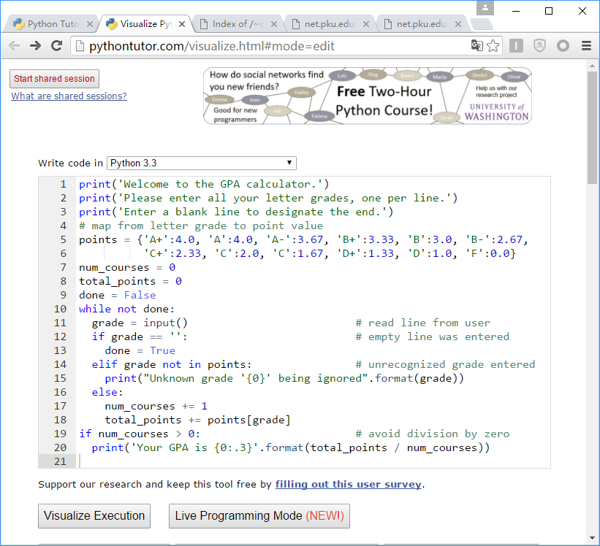
Notes:
http://pythontutor.com/visualize.html

Slide 23
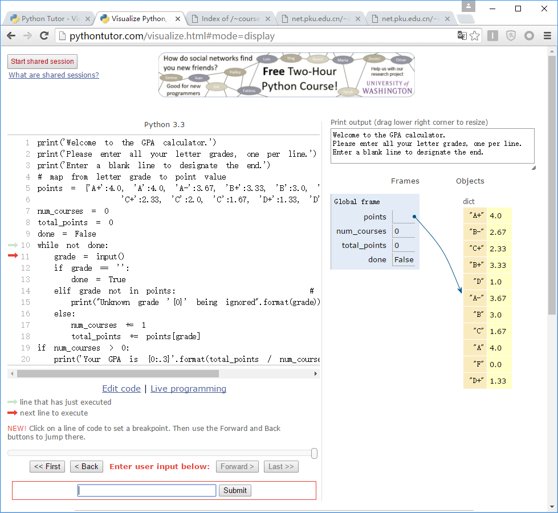

Slide 24
1.2 Objects in Python
1.2.1 Identifiers, Objects, and the Assignment Statement
1.2.2 Creating and Using Objects
1.2.3 Python’s Built-In Classes

Slide 25
1.2 Objects in Python
Python is an object-oriented language and classes form the basis for all data types.
Python’s built-in classes:
the int class for integers,
the float class for floating-point values
the str class for character strings.

Slide 26
Begin SKIP

Slide 27
Terminology
Each object created in a program is an instance of a class.
Each class presents to the outside world a consistent view of the objects that are instances of this class,
The class definition typically specifies
instance variables, also known as data members, that the object contains,
as well as the methods, also known as member functions, that the object can execute.
Notes:
without going into too much unnecessary detail or
giving others access to the inner workings of the objects.

Slide 28
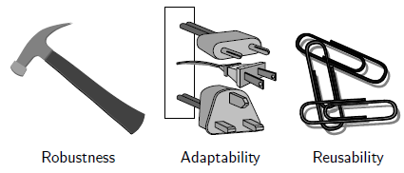
2.1.1 Object-Oriented Design Goals
Robustness
Software needs to be capable of handling unexpected inputs
that are not explicitly defined for its application.
Adaptability
Software needs to be able to evolve over time in response to changing conditions in its environment.
Reusability
The same code should be usable as a component of different systems in various applications.

Slide 29
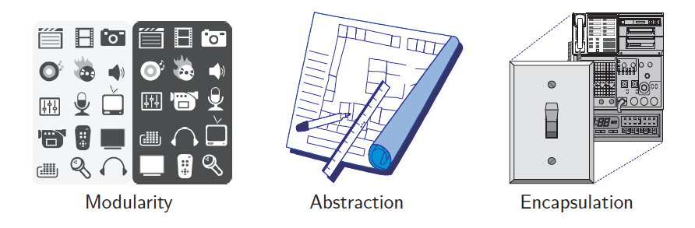
2.1.2 Object-Oriented Design Principles
Modularity
Abstraction
Encapsulation

Slide 30
Modularity
Modern software systems typically consist of several different components that must interact correctly in order for the entire system to work properly.
E.g., In Python, a module is a collection of closely related functions and classes that are defined together in a single file of source code.
The use of modularity helps support the goals
Robustness is greatly increased because it is easier to test and debug separate components
bugs that persist in a complete system might be traced to a particular component, which can be fixed in relative isolation.
If software modules are written in a general way, the modules can be reused when related need arises in other contexts.
This is particularly relevant in a study of data structures, which can typically be designed with sufficient abstraction and generality to be reused in many applications.

Slide 31
Abstract
Abstraction is to distill a system to its most fundamental parts.
Applying the abstraction paradigm to the design of data structures gives rise to abstract data types (ADTs).
An ADT is a model of a data structure that specifies the type of data stored, the operations supported on them, and the types of parameters of the operations.
An ADT specifies what each operation does, but not how it does it.
The collective set of behaviors supported by an ADT is its public interface.

Slide 32

Duck Typing
Python treats abstractions implicitly using a mechanism known as duck typing.
A program can treat objects as having certain functionality and they will behave correctly provided those objects provide this expected functionality.
As an interpreted and dynamically typed language, there is no “compile time” checking of data types in Python, and no formal requirement for declarations of abstract base classes.
Notes:
The term “duck typing” comes from an adage attributed to poet James Whitcomb Riley, stating that “when I see a bird that walks like a duck and swims like a duck and quacks like a duck, I call that bird a duck.”

Slide 33

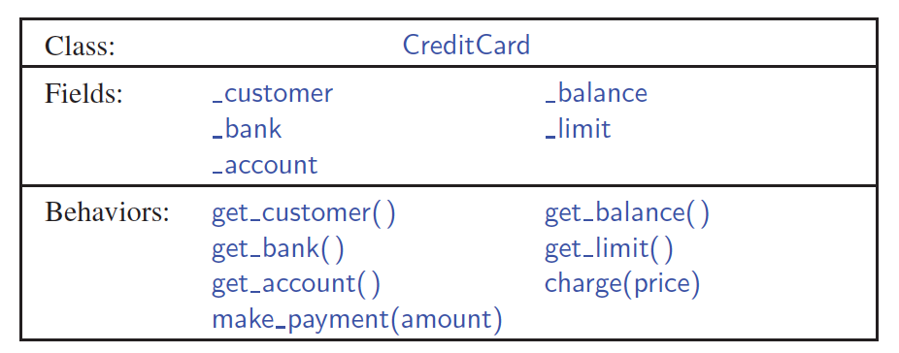
Unified Modeling Language (UML)
Python是面向对象语言。要画类图（class diagram），需要支持UML（Unified Modeling Language）语言的软件。Typora，dia是这类软件。
Typora
A class diagram has three portions.
The name of the class
The recommended instance variables
The recommended methods of the class.
Notes:
https://www.tutorialspoint.com/uml/uml_class_diagram.htm

Slide 34
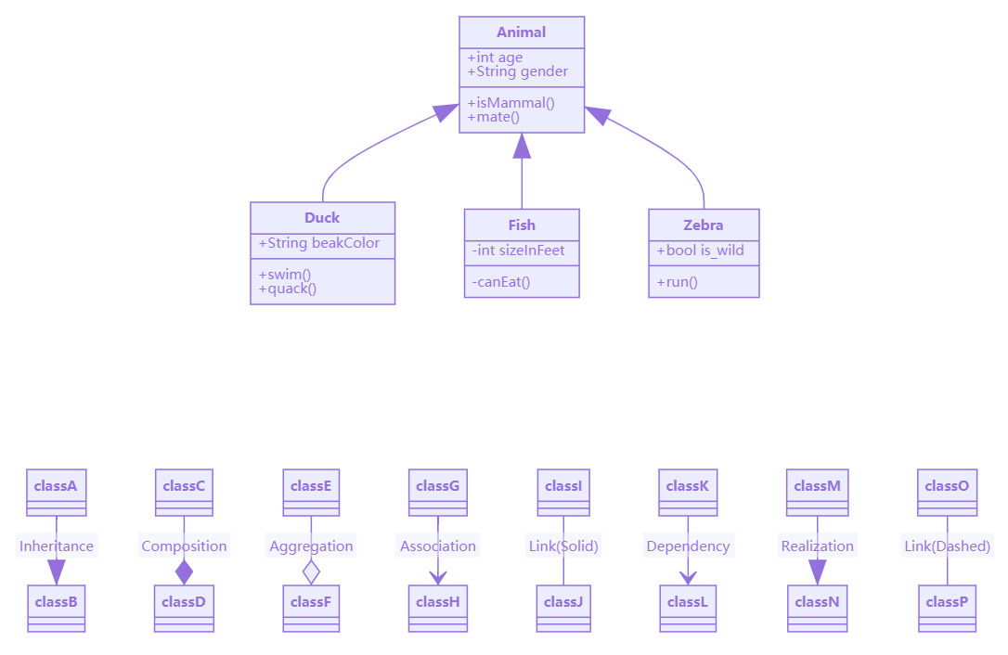
Notes:
classDiagram
Animal <|-- Duck
Animal <|-- Fish
Animal <|-- Zebra
Animal : +int age
Animal : +String gender
Animal: +isMammal()
Animal: +mate()
class Duck{
+String beakColor
+swim()
+quack()
}
class Fish{
-int sizeInFeet
-canEat()
}
class Zebra{
+bool is_wild
+run()
}
classDiagram
classA --|> classB : Inheritance
classC --* classD : Composition
classE --o classF : Aggregation
classG --> classH : Association
classI -- classJ : Link(Solid)
classK ..> classL : Dependency
classM ..|> classN : Realization
classO .. classP : Link(Dashed)

Slide 35
2.3 Class Definitions
A class serves as the primary means for abstraction in object-oriented programming.
In Python, every piece of data is represented as an instance of some class.
A class provides a set of behaviors in the form of member functions (also known as methods),
with implementations that belong to all its instances.
A class also serves as a blueprint for its instances,
effectively determining the way that state information for each instance is represented in the form of attributes
(also known as fields, instance variables, or data members).

Slide 36
The self Identifier
In Python, the self identifier plays a key role.
In any class, there can possibly be many different instances, and each must maintain its own instance variables.
Therefore, each instance stores its own instance variables to reflect its current state.
Syntactically, self identifies the instance upon which a method is invoked.
Notes:
syntactically
美 [sɪn'tæktɪklɪ]
adv.依照句法地，在语句构成上

Slide 37
End SKIP

Slide 38

1.2.1 Identifiers, Objects, and the Assignment Statement
The most important of all Python commands is an assignment statement:
temperature = 98.6
This command establishes temperature as an identifier (also known as a name), and then associates it with the object expressed on the right-hand side of the equal sign, in this case a floating-point object with value 98.6.

Slide 39
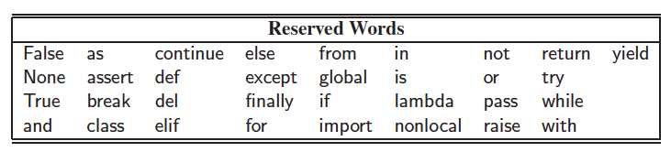
Identifiers
Identifiers in Python are case-sensitive, so temperature and Temperature are distinct names.
Identifiers can be composed of almost any combination of letters, numerals, and underscore characters.
An identifier cannot begin with a numeral and that there are 33 specially reserved words that cannot be used as identifiers:

Slide 40
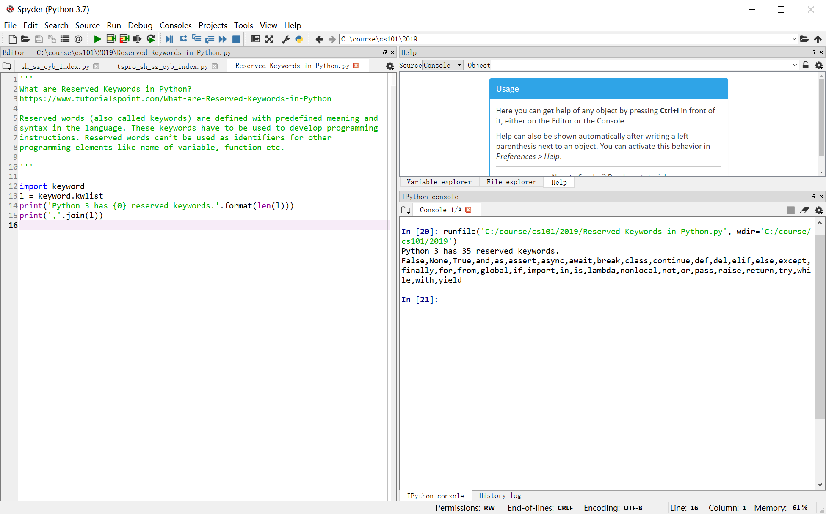
Notes:
'''
What are Reserved Keywords in Python?
https://www.tutorialspoint.com/What-are-Reserved-Keywords-in-Python
Reserved words (also called keywords) are defined with predefined meaning and
syntax in the language. These keywords have to be used to develop programming
instructions. Reserved words can’t be used as identifiers for other
programming elements like name of variable, function etc.
'''
import keyword
l = keyword.kwlist
print('Python 3 has {0} reserved keywords.'.format(len(l)))
print(','.join(l))

Slide 41

Types
Python is a dynamically typed language,
as there is no advance declaration associating an identifier with a particular data type.
An identifier can be associated with any type of object, and it can later be reassigned to another object of the same (or different) type.
Although an identifier has no declared type, the object to which it refers has a definite type.
In our first example, the characters 98.6 are recognized as a floating-point literal, and thus
the identifier temperature is associated with an instance of the float class having that value.

Slide 42
1.2.2 Creating and Using Objects
The process of creating a new instance of a class is known as instantiation.
To instantiate an object we usually invoke the constructor of a class:
w = Widget()
This is assuming that the constructor does not require any parameters.
If the constructor does require parameters, we might use a syntax such as
w = Widget(a, b, c)
Many of Python’s built-in classes a literal form for designating new instances. For example, the command
temperature = 98.6
results in the creation of a new instance of the float class.

Slide 43
Constructors
A user can create an instance of the CreditCard class using a syntax as:
Internally, this results in a call to the specially named __init__ method that serves as the constructor of the class.
Its primary responsibility is to establish the state of a newly created credit card object with appropriate instance variables.

Slide 44
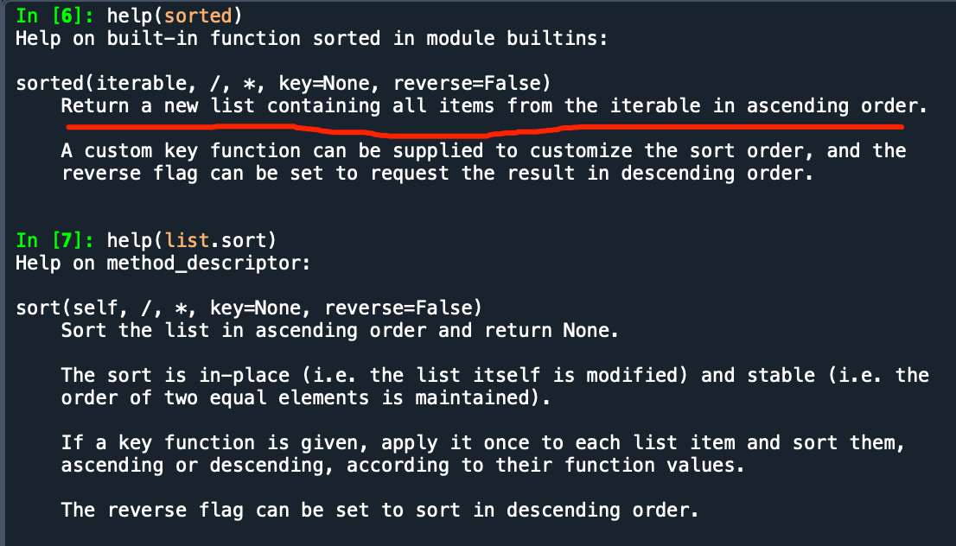
Indirectly create a new instance of a class
call a function that creates and returns such an instance.
For example, Python has a built-in function named sorted (see Section 1.5.2) that
takes a sequence of comparable elements as a parameter and
returns a new instance of the list class containing those elements in sorted order.

Slide 45
Calling Methods
Python supports functions, a syntax such as sorted(data), in which case data is a parameter sent to the function.
Python’s classes may also define one or more methods (also known as member functions), which are invoked on a specific instance of a class using the dot (“.”) operator.
For example, Python’s list class has a method named sort that can be invoked with a syntax such as data.sort( ).
This particular method rearranges the contents of the list so that they are sorted.

Slide 46
1.2.3 Built-In Classes
A class is immutable if each object of that class has a fixed value upon instantiation that cannot subsequently be changed.
For example, the float class is immutable.

Slide 47
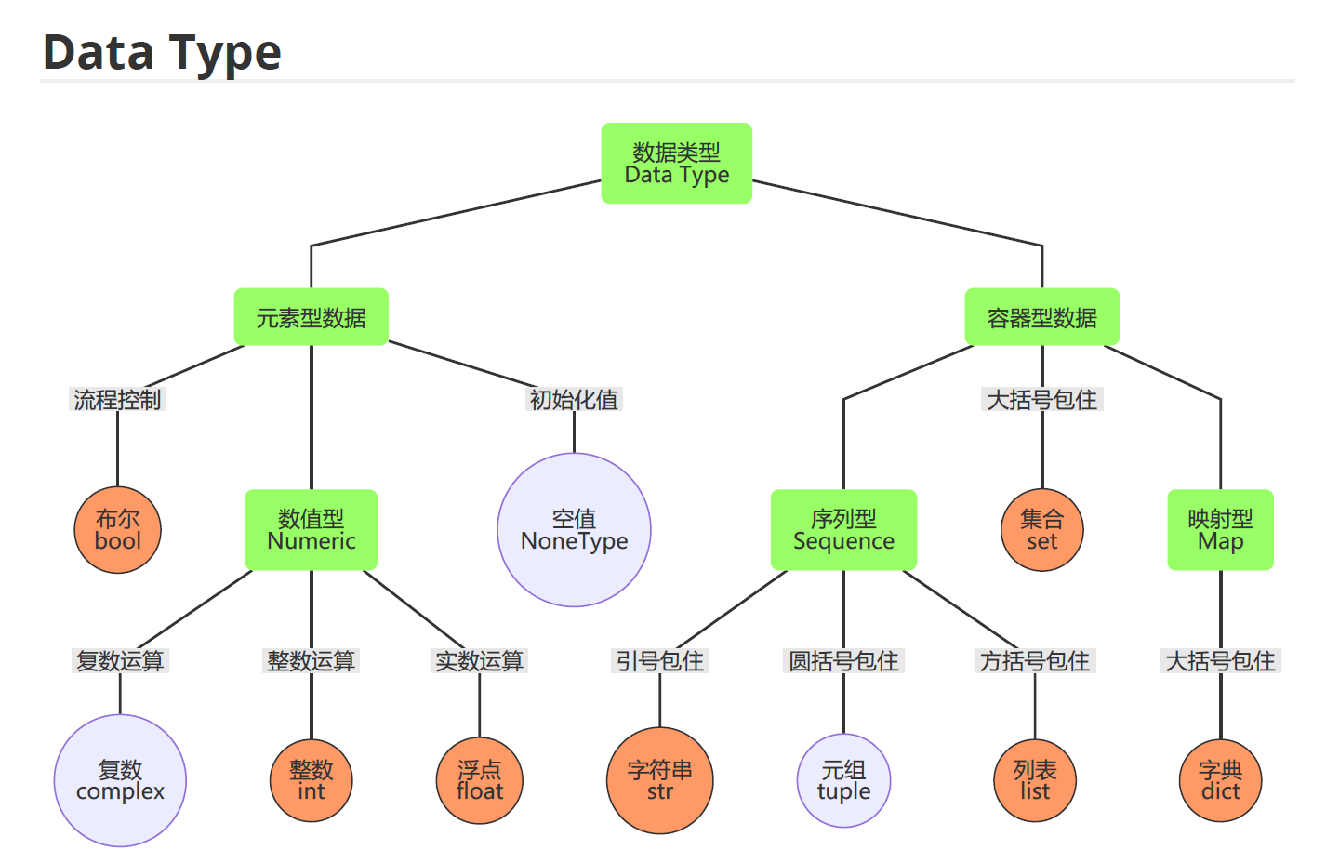

Slide 48
The bool Class
The bool class is used for logical (Boolean) values, and the only two instances of that class are expressed as the literals:
True and False
The default constructor, bool( ), returns False.
Python allows the creation of a Boolean value from a nonboolean type using the syntax bool(foo) for value foo. The interpretation depends upon the type of the parameter.
Numbers evaluate to False if zero, and True if nonzero.
Sequences and other container types, such as strings and lists, evaluate to False if empty and True if nonempty.

Slide 49
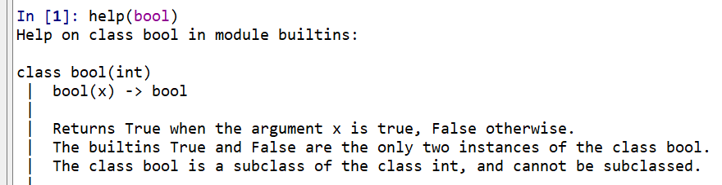
>>>help(bool)

Slide 50
The int Class
The int class is designed to represent integer values with arbitrary magnitude.
Python automatically chooses the internal representation for an integer based upon the magnitude of its value.
The integer constructor, int( ), returns 0 by default.
This constructor can also construct an integer value based upon an existing value of another type.
For example, if f represents a floating-point value, the syntax int(f) produces the truncated value of f.
For example, int(3.14) produces the value 3, while int(−3.9) produces the value −3.
The constructor can also be used to parse a string that represents an integer.
For example, the expression int( 137 ) produces the integer value 137.

Slide 51
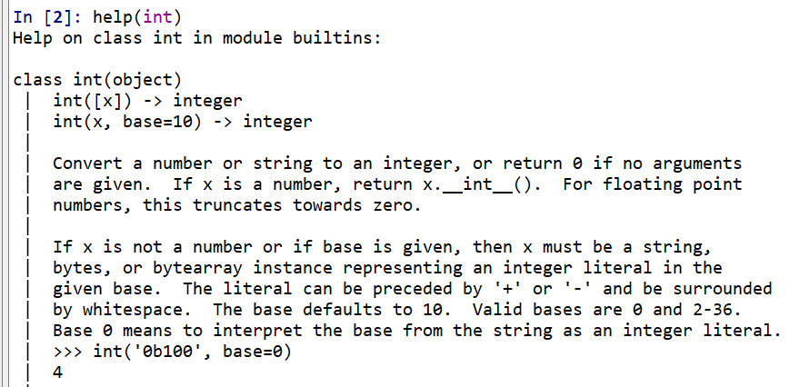
>>>help(int)

Slide 52
The float Class
The float class is the floating-point type in Python.
The floating-point equivalent of an integral number, 2, can be expressed directly as 2.0.
One other form of literal for floating-point values uses scientific notation.
For example, the literal 6.022e23 represents the mathematical value 6.022×10²³.
The constructor float( ) returns 0.0.
When given a parameter, the constructor, float, returns the equivalent floating-point value.
float(2) returns the floating-point value 2.0
float(‘3.14’) returns 3.14

Slide 53
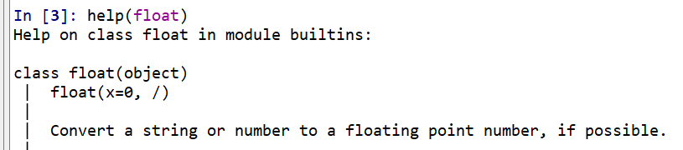
>>>help(float)
Notes:
https://stackoverflow.com/questions/24735311/what-does-the-slash-mean-in-help-output
It signifies the end of the positional only parameters, parameters you cannot use as keyword parameters.

Slide 54
The list Class
A list instance stores a sequence of objects, that is, a sequence of references (or pointers) to objects in the list.
Elements of a list may be arbitrary objects (including the None object).
Lists are array-based sequences and are zero-index
a list of length n has elements indexed from 0 to n−1 inclusive.
Lists have the ability to dynamically expand and contract their capacities as needed.
Python uses the characters [ ] as delimiters for a list literal.
[ ] is an empty list.
[‘red’, ‘green’, ‘blue’] is a list containing three string instances.
The list( ) constructor produces an empty list by default.
The list constructor will accept any iterable parameter.
list(‘hello’) produces a list of individual characters, [‘h’, ‘e’, ‘l’, ‘l’, ‘o’].

Slide 55
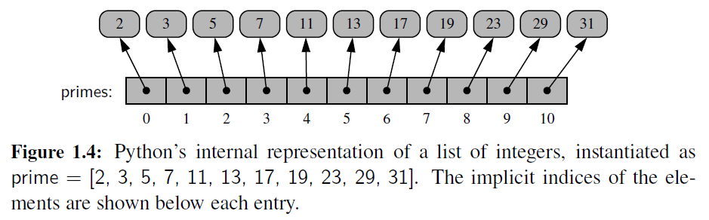
A list instance stores a sequence of objects, that is, a sequence of references (or pointers) to objects in the list.

Slide 56
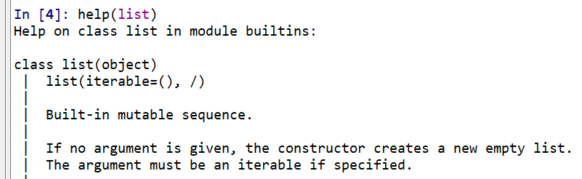
>>>help(list)

Slide 57
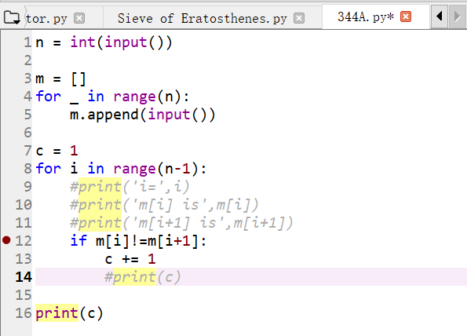
python的数据类型是dynamic type 但是使用前，通常都要声明一下 类似这里的 m = []，即是说明m是list类型 类似的 c = 1，说明c是整数类型，初值为1.
Notes:
n = int(input())
m = []
for _ in range(n):
m.append(input())
c = 1
for i in range(n-1):
#print('i=',i)
#print('m[i] is',m[i])
#print('m[i+1] is',m[i+1])
if m[i]!=m[i+1]:
c += 1
#print(c)
print(c)

Slide 58
The tuple Class
The tuple class provides an immutable (unchangeable) version of a sequence,
which allows instances to have an internal representation that may be more streamlined than that of a list.
Parentheses delimit a tuple.
The empty tuple is ()
To express a tuple of length one as a literal, a comma must be placed after the element, but within the parentheses.
For example, (17,) is a one-element tuple.
Notes:
parentheses
英 [pəˈrenθəsi:z] 美 [pə'renθəsiz]
n.圆括号，插入语，插曲（ parenthesis的名词复数 ）；

Slide 59
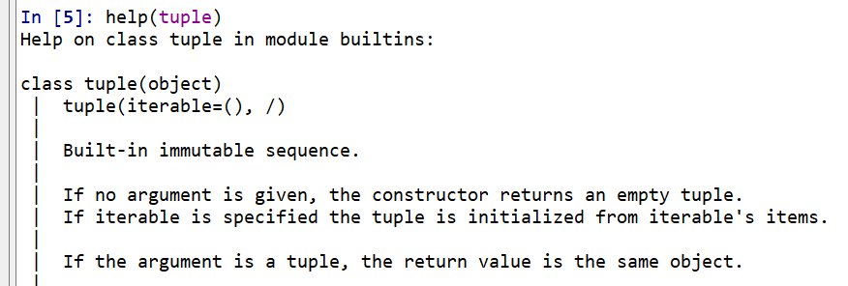
>>>help(tuple)

Slide 60
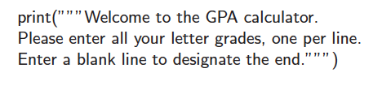
The str Class
String literals can be enclosed in single quotes, as in ‘hello’, or double quotes, as in "hello".
A string can also begin and end with three single or double quotes, if it contains newlines in it.

Slide 61
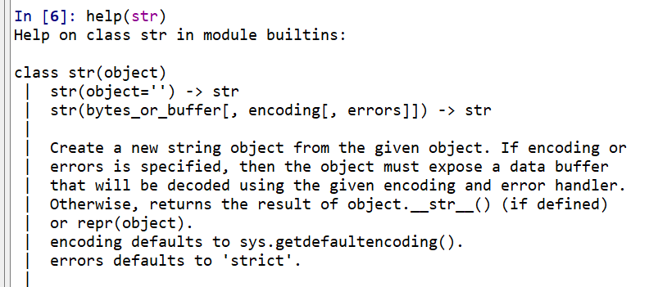
>>>help(str)

Slide 62
The set Class
Python’s set class represents a set, namely a collection of elements, without duplicates, and without an inherent order to those elements.
Only instances of immutable types can be added to a Python set.
Objects such as integers, floating-point numbers, and character strings are eligible to be elements of a set.
The frozenset class is an immutable form of the set type, itself.
Python uses curly braces { and } as delimiters for a set
For example, as {17} or {‘red’, ‘green’, ‘blue’}
The exception to this rule is that { } does not represent an empty set. Instead, the constructor set( ) returns an empty set.
Notes:
eligible
英 [ˈelɪdʒəbl] 美 [ˈɛlɪdʒəbəl]
adj.合适的； 在（法律上或道德上）合格的； 有资格当选的； 称心如意的
n.合格者； 合适者； 称心如意的人； 合乎条件的人（或东西）

Slide 63
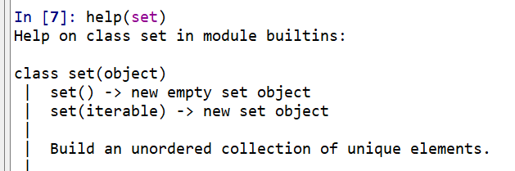
>>>help(set)

Slide 64
The dict Class
Python’s dict class represents a dictionary, or mapping, from a set of distinct keys to associated values.
Python implements a dict using an almost identical approach to that of a set, but with storage of the associated values.
The literal form { } produces an empty dictionary.
A nonempty dictionary is expressed using a comma-separated series of key:value pairs.
For example, the dictionary {‘ga’ : ‘Irish’, ‘de’ : ‘German’} maps ‘ga’ to ‘Irish’ and ‘de’ to ‘German’.
Alternatively, the constructor accepts a sequence of key-value pairs as a parameter, as in dict(pairs) with pairs = [(‘ga’, ‘Irish’), (‘de’, ‘German’)].

Slide 65
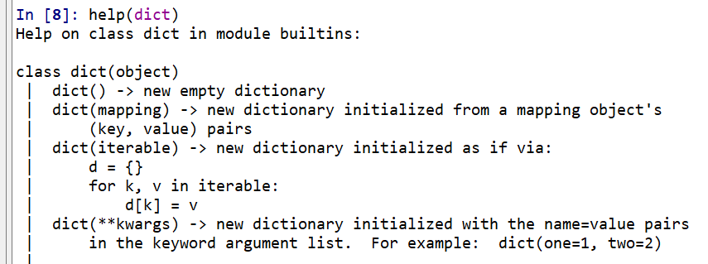
>>>help(dict)

Slide 66
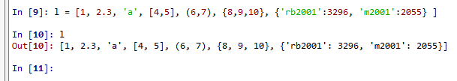
数据类型大杂烩

Slide 67
Determine the type of an object?
https://stackoverflow.com/questions/2225038/determine-the-type-of-an-object

Slide 68
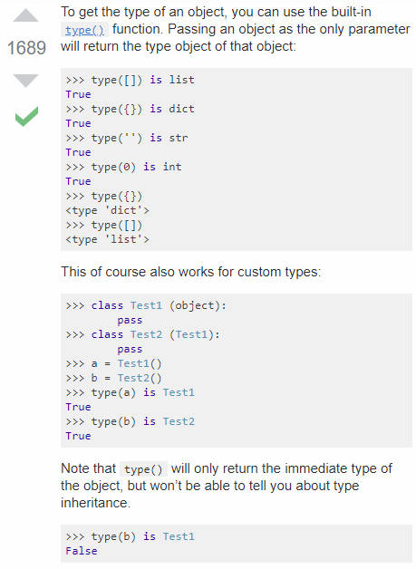
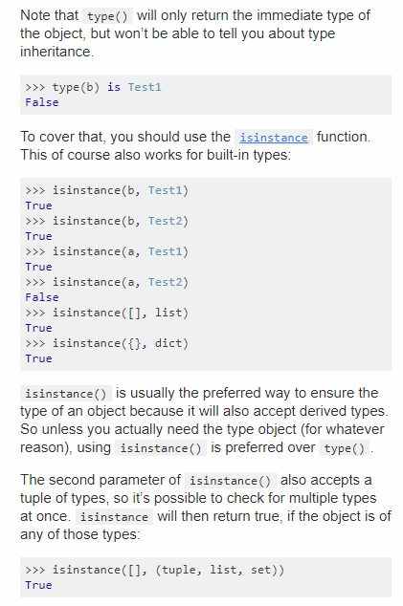

Slide 69
1.3 Expressions, Operators and Operator Precedences
Existing values can be combined into expressions using special symbols and keywords known as operators.
The semantics of an operator depends upon the type of its operands.
For example, when a and b are numbers, the syntax a + b indicates addition,
while if a and b are strings, the operator + indicates concatenation.

Slide 70

Logical Operators
Python supports the following keyword operators for Boolean values:
The and and or operators short-circuit,
in that they do not evaluate the second operand if the result can be determined based on the value of the first operand.

Slide 71
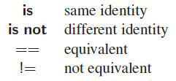
Equality Operators
Python supports the following operators to test two notions of equality:
The expression, a is b, evaluates to True, precisely when identifiers a and b are aliases for the same object.
The expression a == b tests a more general notion of equivalence.
Notes:
In most programming situations,
the equivalence tests == and != are the appropriate operators; use of is and is not
should be reserved for situations in which it is necessary to detect true aliasing.

Slide 72
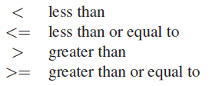
Comparison Operators
Data types may define a natural order via the following operators:
These operators have expected behavior for numeric types, and are defined lexicographically, and case-sensitively, for strings.

Slide 73
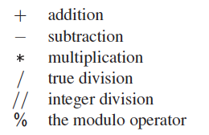
Arithmetic Operators
Python supports the following arithmetic operators:
For addition, subtraction, and multiplication, if both operands have type int, then the result is an int; if one or both operands have type float, the result is a float.
True division is always of type float, integer division is always int (with the result truncated)

Slide 74
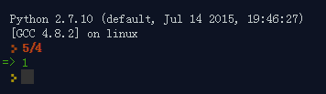

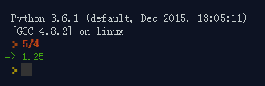
True division is always of type float, integer division is always int (with the result truncated)
in Python 2, / alters behavior when applied to 2 integer operands and returns the result of a floor-division instead:
/ is a different operator in Python 3;
Notes:
这一个斜杠的除号，大家注意一下。在python3里面，可以得到浮点数。但是通常写程序，会写成 5/4.0 ，除数里面有一个浮点数，结果一定是浮点数，就不会有歧义了（因为在python2里面，两个整数除是得整数）。

Slide 75
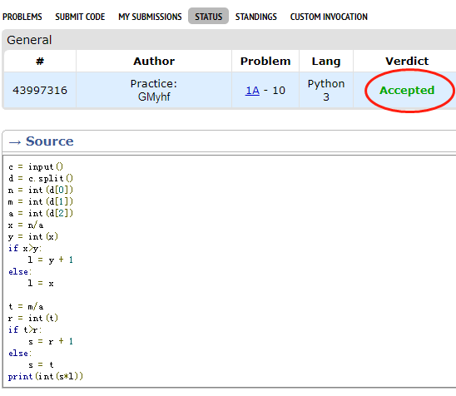
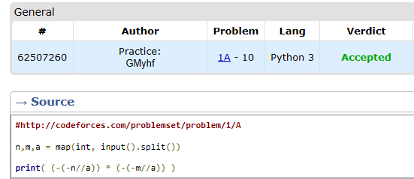
看牛同学程序发现的。
这个斜杠在Python 2 和3里面竟然不一样。

Slide 76

Bitwise Operators
Python provides the following bitwise operators for integers:

Slide 77
Notes:
ASCII reserves the first 32 codes (numbers 0–31 decimal) for control characters: codes originally intended not to carry printable information, but rather to control devices (such as printers) that make use of ASCII. For example, character 10 represents the "line feed" function (which causes a printer to advance its paper), and character 27 represents the "escape" key often found in the top left corner of common keyboards. Code 127 (all seven bits on), another special character, equates to "delete" or "rubout". Though its function re ...

Slide 78
ASCII Structural features
The digits 0-9 are represented with their values in binary prefixed with 0011
Lowercase and uppercase letters only differ in bit pattern by a single bit,
01000001 = 41h = ASCII upper-case letter 'A'
OR 00100000 = 20h <-- this is the bit we want turned on
--------
EQUALS 01100001 = 61h = ASCII lower-case letter 'a'
Notes:
The digits 0-9 are represented with their values in binary prefixed with 0011
(this means that converting BCD to ASCII is simply a matter of taking each BCD nibble separately and prefixing 0011 to it).
Lowercase and uppercase letters only differ in bit pattern by a single bit,
simplifying case conversion to a range test (to avoid converting characters that are not letters) and a single bitwise operation.
Fast case conversion is important because it is often used in case-ignoring search algorithms.
http://teaching.idallen.com/cst8214/08w/notes/bit_operations.txt
*** EXAMPLE 6: Turn any ASCII letter into lower case.
In ASCII, the difference between an upper-case letter and a lower-case
letter is the value of the bit 00100000 (20h), which is turned on in
the lower-case letter. If we "turn on" that bit, the upper-case letter
becomes lower-case. (If the letter was already lower-case, the 20h bit
is already on; turning it on makes no difference.)
To make any ASCII letter lower-case, we must "turn on" the 20h bit.
This is called ORing-in a bit, since we use the bitwise Boolean
OR operator:
01000001 = 41h = ASCII upper-case letter 'A'
OR 00100000 = 20h <-- this is the bit we want turned on
--------
EQUALS 01100001 = 61h = ASCII lower-case letter 'a'
In C language:
char uppera = 'A';
char lowera = uppera | 0x20; /* bitwise OR with 20h */
char lowerb = 'B' | 0x20; /* bitwise OR with 20h */
... etc ...
char lowerz = 'Z' | 0x20; /* bitwise OR with 20h */

Slide 79

Notes:
uppera = ord('A')
lowera = uppera | 0x20 # bitwise OR with 20h
print(chr(lowera))
lowera = uppera | (1<<5)
print(chr(lowera))
lowera = ord('a')
uppera = lowera & ~0x20 # bitwise AND with 10111111
print(chr(uppera))
uppera = lowera & ~(1<<5)
print(chr(uppera))

Slide 80

Sequence Operators
Each of Python’s built-in sequence types (str, tuple, and list) support the following operator syntaxes:

Slide 81


Sequence Comparisons
Sequences define comparison operations based on lexicographic order, performing an element by element comparison until the first difference is found.
For example, [5, 6, 9] < [5, 7] because of the entries at index 1.

Slide 82

Operators for Sets
Sets and frozensets support the following operators:

Slide 83

Operators for Dictionaries
The supported operators for objects of type dict are as follows:
Notes:
Dictionaries, like sets, do not maintain a well-defined order on their elements.
Furthermore, the concept of a subset is not typically meaningful for dictionaries, so
the dict class does not support operators such as <.

Slide 84
Extended Assignment Operators
alpha = [1, 2, 3]
beta = alpha # an alias for alpha
beta += [4, 5] # extends the original list with two more elements
beta = beta + [6, 7] # reassigns beta to a new list [1, 2, 3, 4, 5, 6, 7]
print(alpha) # will be [1, 2, 3, 4, 5]
This example demonstrates the subtle difference between the list semantics for the syntax beta += foo versus beta = beta + foo.
Notes:
Python supports an extended assignment operator for most binary operators, for
example, allowing a syntax such as count += 5. By default, this is a shorthand for
the more verbose count = count + 5. For an immutable type, such as a number or
a string, one should not presume that this syntax changes the value of the existing
object, but instead that it will reassign the identifier to a newly constructed value.
(See discussion of Figure 1.3.) However, it is possible for a type to redefine such
semantics to mutate the object, as the list class does for the += operator.

Slide 85
1.3.1 Compound expressions and Operator Precedence
Programming languages must have clear rules for the order in which compound expressions, such as 5 + 2 3, are evaluated.
Python allows a chained assignment,
such as x = y = 0, to assign multiple identifiers to the rightmost value.
Python also allows the chaining of comparison operators.
For example,
the expression 1 <= x + y <= 10 is evaluated as the compound (1 <= x + y) and (x + y <= 10),
but without computing the intermediate value x + y twice.

Slide 86

Operator Precedence
with categories ordered from highest precedence to lowest precedence.
Use expr to denote a literal, identifier, or result of a previously evaluated expression.
Operators without explicit mention of expr are binary operators, with syntax expr1 operator expr2.

Slide 87
Summary
图灵机的构成
一条存储带
双向无限延长
上有一个个小方格
每个小方格可以存储一个数字
一个控制器
包含一个读写头，可以读、写、更改存储带上每一格的数字
可以接受设定好的程序语句
可以存储当前自身的状态
可以变换自身的状态
可以沿着存储带一格一格地左移/右移

Slide 88
Notes:
ASCII reserves the first 32 codes (numbers 0–31 decimal) for control characters: codes originally intended not to carry printable information, but rather to control devices (such as printers) that make use of ASCII. For example, character 10 represents the "line feed" function (which causes a printer to advance its paper), and character 27 represents the "escape" key often found in the top left corner of common keyboards. Code 127 (all seven bits on), another special character, equates to "delete" or "rubout". Though its function re ...

Slide 89
Summary: Python Build-In Classes

